Slide 1

Reliability of Data-Intensive Distributed File Systems
A Simulation Approach
Corentin Debains (A20274998)
Pedro Alvarez-Tabio Togores (A20274308)
Firat Karakusoglu (A20276376)

Slide 2
Content
Background & Motivation
Metrics definition
HDFS replication system description
Simulation Approach
Results
Future work

Slide 3
Background & Motivation
Di-DFS
Reliability of DFS
GFS & HDFS
TriftStore

Slide 4
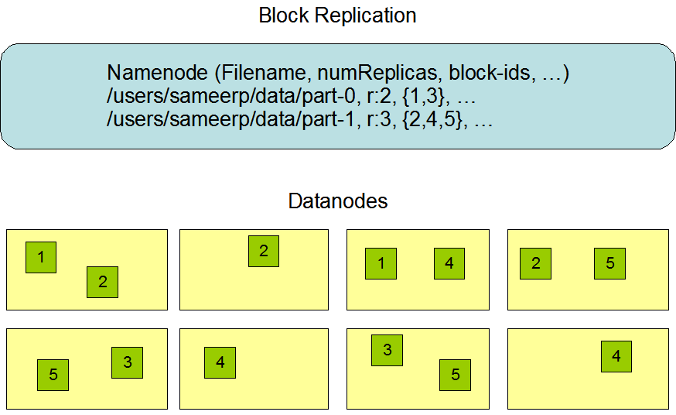
Di-DFS (Data Intensive Distributed File Systems)
What is DFS and what do they do?
Single hierarchical file system that assists in organizing shared folders on multiple computers
Support data intensive computing frameworks
How do they work?
Breaks down data into chunks/blocks
Distribute related chunks/blocks onto each node
How do they handle failures?
Replication based data placement
Popular DFS Systems?
GFS (Google File System)
Hadoop (HDFS)
CloudStore
Notes:
What is DFS? (http://www.tech-faq.com/understanding-fault-tolerance.html)
Distributed file system (Dfs) is a single hierarchical file system that assists in organizing shared folders on multiple computers in the network.
Dfs provides a single logical file system structure, and can also provide a fault-tolerant storage system.
Dfs provides load balancing and fault tolerance features that in turn provide high availability of the file system and improved performance.
Developed to support data intensive computing frameworks.
What is data intensive computing framework?
These frameworks allow managing systems with large amount of data mainly by distributing data among different disks.
MapReduce is one of these frameworks that is capable of handling data intensive computations.
*Distribution can be drawn to the board
Few sentences about gfs, hadoop and cloudstore
When they are started being developed
Their differences & similarities
Main architectures
GFS

Slide 5
Reliability of DFS
What affects reliability?
Software, network, operational, environmental failures
Reliability factors affect DFS performance
Replication Degree
Heart beat poll interval
Network bandwidth
Block Size
Notes:
Software Failures: Determining the reason of a system outage can be quite intricate. Virus protection defects can cause system outages. Often, incorrect system configuration can also lead to system failures.
Network Failures: Any changes to the network design or topology of a layer of the protocol stack can have an impact on the entire network. It is therefore better to assess each layer when making any network changes.
Operational Failures: Utilizing stringent operational processes will greatly reduce operational failures. Backup strategies and processes should be defined and implemented.
Environmental failures are failures that result in data loss or service loss that are brought about by power outages caused by disasters like hurricanes and snowstorms.
Reliability factors affect DFS performance
Replication Degree
Obviously, the reliability is proportionally impacted by the replication degree.
A higher replication degree usually means higher reliability.
However, the storage space is not free, and more data communication cost will be incurred for more replicas.
There is a trade-off with the selection of replication degree: we need to balance between reliability and space utilization.
Heart beat poll interval
The namenode periodically polls datanodes and identify the malfunctioning ones.
A shorter poll interval helps to identify the corrupted nodes and data blocks earlier.
However, the shorter poll interval will inevitably burden the centralized metadata server.
Network bandwidth
The re-replication depends largely on the network bandwidth in the system.
The problem is exaggerated for distributed computing environment, where the upload network bandwidth is bounded with several hundreds of Kb/s only.
Block Size
Intuitively, block size impacts the reliability of DI-DFS.
However, the impact is still vague. A larger block size usually implies more cost in re-replication.
However, the number of corrupted data blocks will also be reduced with higher block size.
The data placement mechanism
First, if the failure patterns of the datanodes are correlated, an intelligent data placement mechanism is needed to disperse the replicas of one data blocks to unrelated nodes.
if the nodes are not correlated, the placement of data blocks for the same file could still be optimization problems.

Slide 6
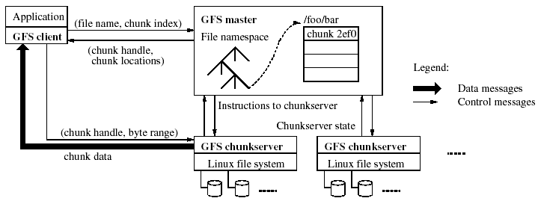
GFS – Google File System
Architecture Files are divided into chunks Fixed-size chunks (64MB) Replicated over chunkservers, called replicas Unique 64-bit chunk handles Chunks as Linux files Single master | Multiple chunkservers Grouped into Racks Connected through switches Multiple clients Master/chunkserver coordination HeartBeat messages
Look up the file namespace & find chunk locations
Contacts GFS Master
Receive Chunk Locations
Obtain Data
Pickup a chunk server
Notes:
A cluster consists of
A single master
Multiple chunkservers
Multiple clients
Let’s how a client reads a file
First, the client sends the filename and chunk index to the master
The master will look up the filenamespace to fine the chunk handle and the locations of its replicas.
The chunk handle and chunk locations are sent back to the client
The client picks up a chunkserver and uses chunk handle to read the data.
Heartbeat messages are used for the interaction between master and chunkservers

Slide 7

HDFS – Hadoop File System
Notes:
HDFS has a master/slave architecture.
An HDFS cluster consists of a single NameNode, a master server that manages the file system namespace and regulates access to files by clients.
In addition, there are a number of DataNodes, usually one per node in the cluster, which manage storage attached to the nodes that they run on.
HDFS exposes a file system namespace and allows user data to be stored in files.
Internally, a file is split into one or more blocks and these blocks are stored in a set of DataNodes.
The NameNode executes file system namespace operations like opening, closing, and renaming files and directories.
It also determines the mapping of blocks to DataNodes.
The DataNodes are responsible for serving read and write requests from the file system’s clients.
The DataNodes also perform block creation, deletion, and replication upon instruction from the NameNode.
The NameNode and DataNode are pieces of software designed to run on commodity machines. These machines typically run a GNU/Linux operating system (OS). HDFS is built using the Java language; any machine that supports Java can run the NameNode or the DataNode software. Usage of the highly portable Java language means that HDFS can be deployed on a wide range of machines. A typical deployment has a dedicated machine that runs only the NameNode software. Each of the other machines in the cluster runs one instance of the DataNode software. The architecture does not preclude running multiple DataNodes on the same machine but in a real deployment that is rarely the case.
The existence of a single NameNode in a cluster greatly simplifies the architecture of the system. The NameNode is the arbitrator and repository for all HDFS metadata. The system is designed in such a way that user data never flows through the NameNode.

Slide 8
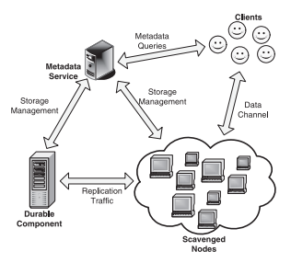
ThriftStore Replicated Storage System
ThriftStore, a storage architecture that integrates volatile storage, from which applications read data, and durable storage, which is responsible for replication in case of a lost in volatile storage.
Similarities with HDFS?
Central metadata management
Replication based storage system
Simulation Approach
Simulates volatile and durable nodes
Monitors the state of objects
Monitors the amount of traffic
Notes:
Thriftstore replica repair model
The system seeks to maintain a minimum replication level n for all objects at all times on the volatile nodes. Once a failed volatile node is detected, the system reacts by creating additional copies to increase the replication level back to n
Each volatile node limits the bandwidth allocated for replica repair to b .
If the replication level on the volatile nodes goes down to 0 for a specific object,
then the durable component creates, with a repair bandwidth limited to B ,a new copy of the object on one of the volatile nodes.
The new copy is then used to create additional replicas on other volatile nodes up to the replication level n

Slide 9
Metrics Definition
Durability
Mean Time to Repair Workload & Scale

Slide 10
Durability
Durability is the time before a data is lost globally when MTTF is greater than MTTR.
E.g. Durability of 0.99 means, a file has 99% probability of being available after applying failures.
For example, if we apply constant rate of failure in the system, then we can measure durability by evaluating how long a file is available in the system
Notes:
durability is the time before a data is lost globally when MTTF is greater than MTTR.
For example, if we apply a constant rate of failure in the system, then we can measure durability by evaluating how long a file is available in the system.
Glacier ensures that the object can be recovered even if the system suffers from a large-scale, correlated Byzantine failure.
The durability guarantee given by Glacier implies that, if the failure affects a fraction f<= f(max) of the storage nodes, each object survives with probability P >= P(min). The parameters f(max) and P(min) determine the overhead and can be adjusted to the requirements of the application.
Glacier ensures durability by spreading redundant data for each object over a large number of storage nodes. These nodes periodically communicate with each other to detect data loss, and to re-create redundancy when necessary. After a large-scale failure event, Glacier reconstitutes aggregates from surviving fragments and reinserts objects into the primary store. The recovery proceeds gradually to prevent network overload. Additionally, an on-demand primitive is available to recover objects synchronously when requested by the application.
What is glacier?
Glacier: Highly durable, decentralized storage despite massive correlated failures
Glacier is a system designed to handle massive failure. It uses erasure codes to duplicate information and distribute it. It can handle a large-scale failure due to that redundancy. In case of massive failure among the storage nodes, the system can enter a recovery mode.
As metrics, the system designers used statistical durability to handle a specific % of system failure during a large-scale failure. Also, they measured the number of fragments impacted by the loss.

Slide 11
Mean Time to Repair
MTTR is the time for a block to be re-replicated till it reaches a stable state.
Data loss happens if MTTR > Number of Replicas * MTTF
Down Time
UpTime
Up
Block State
Time to Repair
Down
off
1st failure
2nd failure
3rd failure
Time to Repair { up time – down time }
∑ { up time – down time }
Mean Time to Repair =
number of failures
Notes:
MTTR is the time for a block to be re-replicated back to normal.
Data loss can happen if MTTR > Number of Replicas*MTTF
This sub-metric is for knowing the time required to repair the system once failures began to happen.
During implementation, we will count the time in the meaning of seconds once system starts repairing the system till it reaches a full reliable state.
The repair process can be measured to different steps, the emergency repair and total repair, similarly to the metrics used by Google in GFS
Time to repair is the total time duration required to repair failures and reach a full reliable state.
Reliable state means; system has required number of replicas for each chunk and there is no any data pieces that is un-accessible by the system.

Slide 12

Workload & Scale
What is Workload?
The amount of work/data assigned to a person/system.
Which affects does it have?
Workload changes systems’ performance evaluation results.
E.g. applying a long term workload ages a file system and aged file systems reacts different compared to empty file systems.
What will workload be look like in our simulator?
In our simulator, we will submit different amounts of workloads, which will be scaled up to 100,000 nodes, to the file system to explore its reaction over changes in the workload.
Notes:
The workload that we are going to submit to the system should be enough to
fill around 30% of the system storage and the simulator will keep submitting data over time to
keep activity into the system. The scale will be linked to the simulator scalability and we don’t
want to corrupt the observation with simulation limits. So we plan to measure the simulator’s
performances to adapt the simulated scalability. We expect to be able to scale to thousand
nodes.

Slide 13
HDFS - Replication System
Workflows
Parameters
Possible Limitations

Slide 14
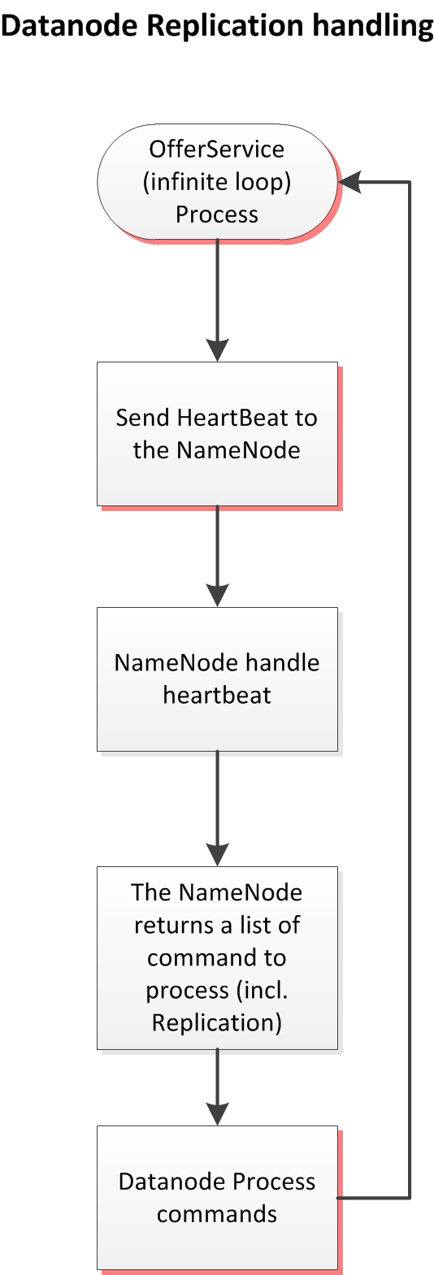
Heartbeats – I’m here! What should I do now?
RPC Call
Performed by the Datanode
Send several information (capacity, disk usage and remaining, number of current transfers)
Period: heartbeat Interval
Default: 3s
UTILITY 1: Get a proof of activity (Hearbeat)
UTILITY 2: Transmit commands
Only way for NN to transmit commands to DN
In the code:
OfferService (DN), handleHeartbeat (NN)

Slide 15
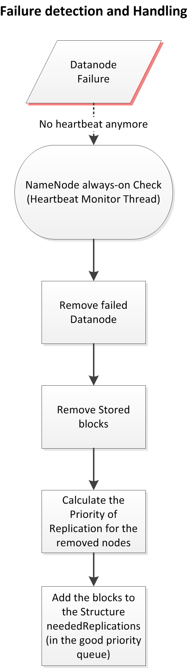
Heartbeats – Who’s alive?
Parameters
heartbeatExpireInterval
Default: 630s (10 heartbeats+2 Recheck Interval)
heartbeatRecheckInterval
Default: 300s
Structures
READ: heartbeats List
All the nodes and their last hearbeats
WRITE: neededReplications List
To add the blocks that need replication
In the code: HeartbeatMonitor

Slide 16
Priorities
3 Different Priority queues
Level 1 (Highest)
Blocks with only 1 live replica
Blocks with only decommissioned replicas (stored by nodes in decommission)
Level 2
Blocks with only a third of required replicas
Level 3 (Smallest)
All the others

Slide 17
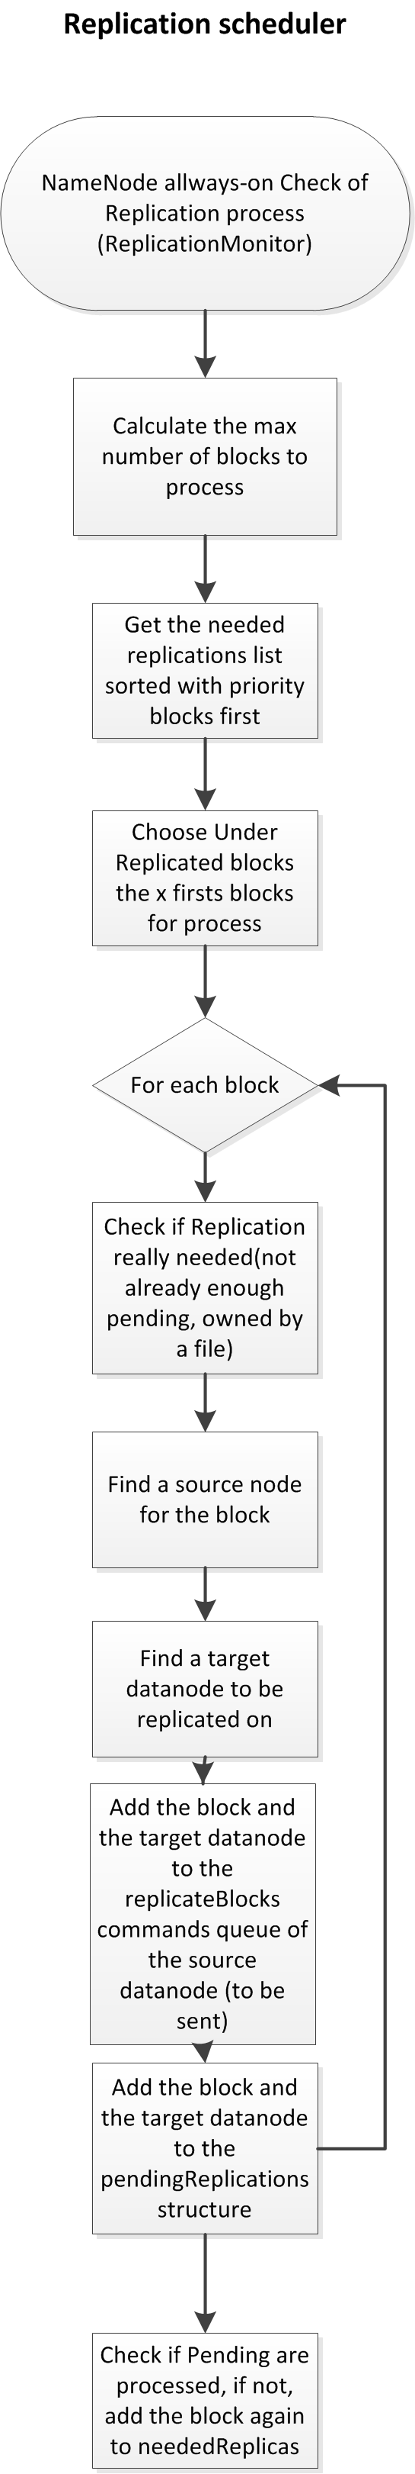
Replication – Let’s schedule some replications!
Parameters
Blocks to Process per Iteration
Default: #aliveNodes x2
heartbeatRecheckInterval
Default: 3s
Structures
READ: neededReplications List
To get the blocks that need to be replicated
WRITE: chosen Source commandList & PendingReplications List
To add the blocks that need replication
To save which blocks are already scheduled
In the code: ReplicationMonitor

Slide 18
Nodes choices for replication
Source Choice
Target Choice
By Elimination in the Block’s Containing Nodes:
Corrupt? X
Maximum Stream? X
Scheduled for removal? X
Already Decommissioned? X
Decommission in Progress? Preferred!
Randomly (50/50)
By order of preference:
1) By Rack, same rack preferred
2) By Locality, closer preferred first
3) By Locality, far preferred
4) Randomly in the available nodes

Slide 19
Possible Limitations
Checking intervals can be long…
If a disk has a probability of failure is three years
A disk fail every 630s for clusters ~150k disks
A Byzantine Failure could trigger a big amount of replications at the same time…
But the priorities can handle the urgent work first
…But it doesn’t sound like a problem

Slide 20
Simulation Approach
Why Simulation?
Simulation Design for HDFS
Simulator Details

Slide 21
Why Simulation?
To overcome the limitations of the analytical model
To evaluate the effect of the deployment platform and workload characteristics on data availability.
Try to look at the system from a bigger scale while isolating some parts to concentrate on particular mechanism(s) only; e.g. replication.
Our simulation aims to focus only in the replication part. To keep it simple, the simulator only comprises the replication code of HDFS.

Slide 22
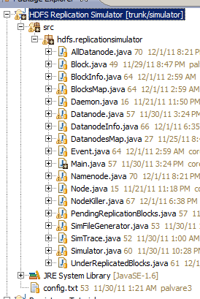
Simulation Approach for HDFS
Our simulation is capable of;
Creating namenode
Creating datanodes
Distributing file blocks to datanodes
Simulating a node failure/repair process
Namenode Created.
15 Datanodes Created.
1000 Blocks distributed
[02/12/2011 07:52:58.729] Namenode heartbeat monitor created
[02/12/2011 07:52:58.729] Started NodeKiller
[02/12/2011 07:53:00.953] Namenode has detected a failure in Datanode #12
[02/12/2011 07:53:00.953] Namenode has scheduled to repair block #2
[02/12/2011 07:53:00.953] Namenode has scheduled to repair block #5
.
.
.
[02/12/2011 07:53:01.025] Namenode has scheduled to repair block #998
END

Slide 23

Simulation parameters
SimFileGenerator.java
Generates a file, config.txt with parameters:
file=config.txt replica=5 bw=1024 block=64 heartbeat=1000 timeout=3 MTTF=3000 distr=1 nodes=15 failPercent=20 nBlocks=1000
Poisson distribution, with expected failures as parameter
Exponential distribution for failure arrivals

Slide 24
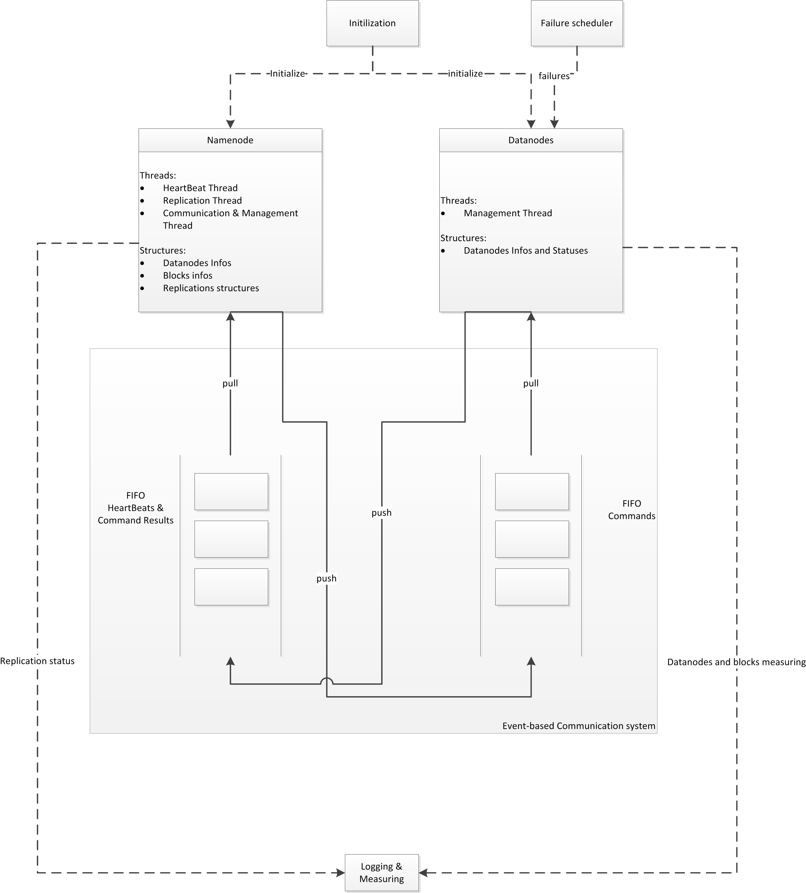
Simulator design

Slide 25
Conclusions and Future Work

Slide 26
Conclusions
The HDFS simulator we developed represents an accurate tradeoff between simplification and the actual behavior of HDFS
We have achieved a great knowledge of the internal replication mechanisms in HDFS, which are not at all trivial
Preliminary results (still need curation) show that durability in HDFS remains constant with great numbers: ~0.99
On the other hand, MTTR is very dependent on the frequency of failures in the system, and can scale up dramatically
However, we expect to fix some minor bugs remaining to return more accurate results

Slide 27
Future Work
Finishing the measure taking process
We need to curate the results in every trace
Keep extending the simulator to have even more similarity with HDFS
e.g. Supporting load balancing

Slide 28
Just a few references…
[1] J. Dean and S. Ghemawat, "MapReduce: Simplified Data Processing on Large Clusters," Communications of the ACM - 50th anniversary issue: 1958-2008, vol. 51, no. 1, 2008.
[2] S. Ghemawat, H. Gobioff, and S.-T. Leung., "The Google File System," in Proc. of ACM Symposium on Operating System Principles, SOSP, 2003.
[3] Hadoop Distribute Filesystem Website. [Online]. http://hadoop.apache.org/hdfs/
[4] Kosmos Distributed Filesystem (CloudStore) website. [Online]. http://code.google.com/p/kosmosfs/
[5] I. Raicu, I. Foster, P. Beckman, "Making a Case for Distributed File Systems at Exascale," in Proc. of ACM Workshop on Large-scale System and Application Performance (LSAP), 2011.
[6] Kaushik, R.T.; Bhandarkar, M.; Nahrstedt, K., "Evaluation and Analysis of GreenHDFS: A Self-Adaptive, Energy-Conserving Variant of the Hadoop Distributed File System," in Proc. of Second International Conference on Cloud Computing Technology and Science (CloudCom), 2010.
[7] H. Lin, X. Ma, J. Archuleta, W. Feng, M. Gardner, Z. Zhang, "MOON: MapReduce On Opportunistic eNvironments," in Proc. of the 19th ACM International Symposium on High Performance Distributed Computing (HPDC), 2010.
[8] Guanying Wang, Ali R. Butt, Prashant Pandey, and Karan Gupta, "A Simulation Approach to Evaluating Design Decisions in MapReduce Setups," in Proc. of the 17th Annual Meeting of the IEEE/ACM International Symposium on Modelling, Analysis and Simulation of Computer and Telecommunication Systems (MASCOTS), 2009.
[9] H. Jin, X. Yang, X. -H. Sun and I. Raicu, "An Empirical Evaluation of MapReduce under Interruptions," in Cloud Computing and its Applications (CCA) , 2011.

Slide 29
Questions
?

